Slide 1
Robot Project Meeting 14 – 04/04/2019
Bourgogne, Colrat, Evaux, Gaizi, Nicolle – ACE TEAM
Chenaud - PTE

Slide 2
Last Meeting
Next steps for the project:
Virgile will take over the PCB design that is almost finished
Create a New GUI in C++ or Processing for Mode 3 where we would want to map the environment
Make a more reliable protocol of communication between the Bluetooth and the GUI/Android App with start bit, end bit and Acknowledgement: According to Virgile, LIN protocol is already secure enough
Clarification regarding the goals for Mode 3:
CNN detects the numbers and sends the relative position to the AURIX
AURIX is constantly calculating its position in the map, with the next version of the enslavement, the duty cycle of the wheels will depend on the position of the Number
When a number is detected, its position should be sent to the GUI to map the environment
Monthly meetings instead of bi-weekly

Slide 3
Reocurring issue with Bluetooth Communication
Sometimes for no apparent reason the commands sent via bluetooth from the GUI or the Android app are not received by the robot
The bluetooth connection isn‘t broken but randomly some commands sent are not received
It never was a problem with Putty, we will have to investigate before printing the PCB

Slide 4
Virgile, GUI & PCB design
Done:
Schematic done
PCB layout design done
To do:
Valid the schematic:
Check the problem with the Bluetooth module
Print the board (and mount the components)
Choose between Processing and C++ (with Qt) to make the new GUI
Processing code simpler than C++, Processing is made to build GUIs
C++ more portable, more convenient for next year students

Slide 5
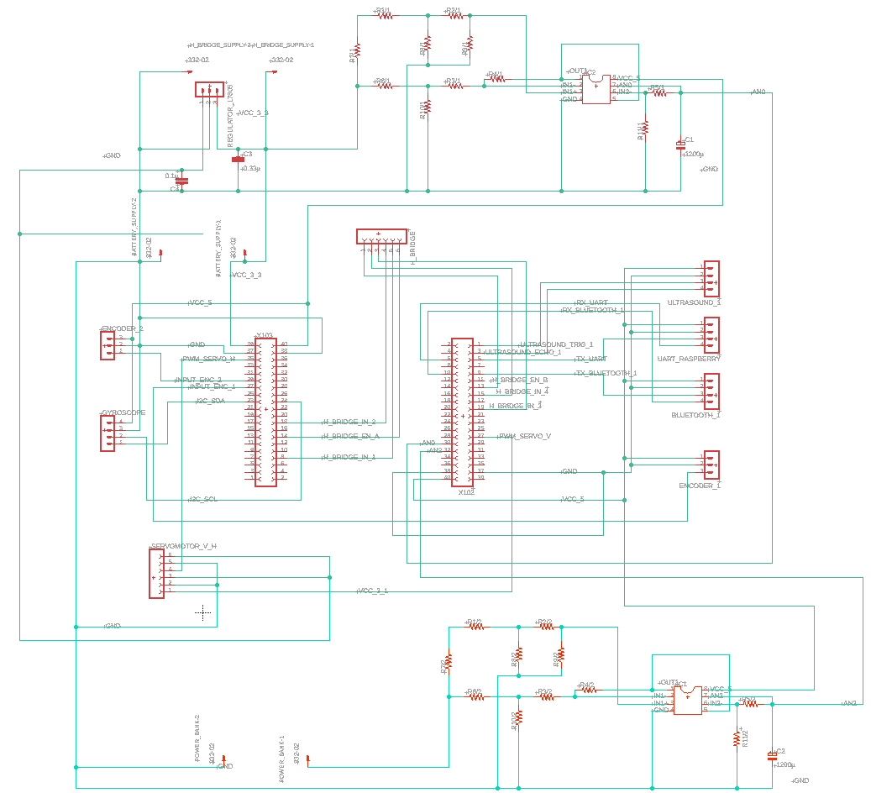
Schematic

Slide 6
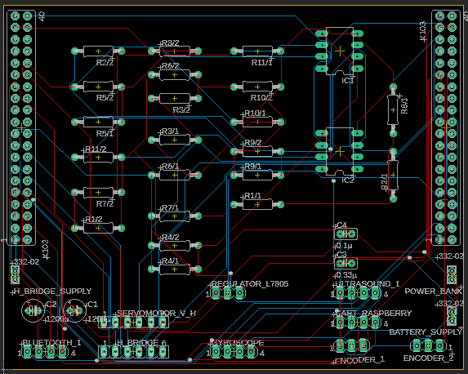
Board design

Slide 7
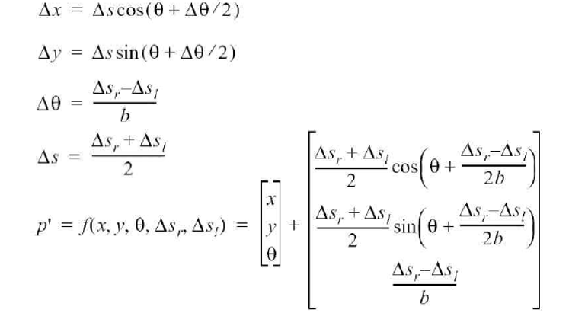
Amine, Position calculation
To calculate in real time the position of the robot we are using the encoders and the gyroscope. Our program is based on this formula:
Position on the x axis, ∆s is the distance traveled by the robot between 2 interrupts, based on encoders
Position on the y axis
Angle Orientation change between 2 interrupts, we do it based on Gyroscope Yaw angle mesurement
Position Update
Formula

Slide 8
Amine & Guillaume, testing the position calculation
After some tests it seems that although we have coherent results, there seem to be a lack of precision
The values given by the gyroscope are sometimes not accurate which translates in the x and y calculation.
Example: X measured value is superior to its calculated value while Y measured value is inferior to its calculated value. If the angle is not accurate, the bigger the angle value, the smaller the cosine is and the bigger the sine is which affects the calculated value
One solution could be to calculate the angle variation with the values from the encoders and compare them to the values of gyroscope to get a more precise angle variation

Slide 9
Amine, Position Calculation
To do:
Investigate the Bluetooth problem
Make sure the Position calculation is accurate with Guillaume
Verify the Error calculation for the enslavement
Start Working on the enslavement
Deadline: 09/05/2019

Slide 10
Summary: next steps
Position accurate calculation and Enslavement to go to desired position
Investigate and solve Bluetooth commands reception problem
PCB print and mount to do a proper functionning handover
New GUI to control mode 1, 2 and map the environment in mode 3 (in C++ or Processing)
Update of the Android App for Mode 3
A new obstacle avoidance algorithm will be needed for mode 3: if we have a desired position, and we detect an obstacle in front we should be able to go around the obstacle and then end up on the desired position
Someone would have to start working on this

